Slide 1
The hemic and lymphatic systems
A SDDVA Production

Slide 2
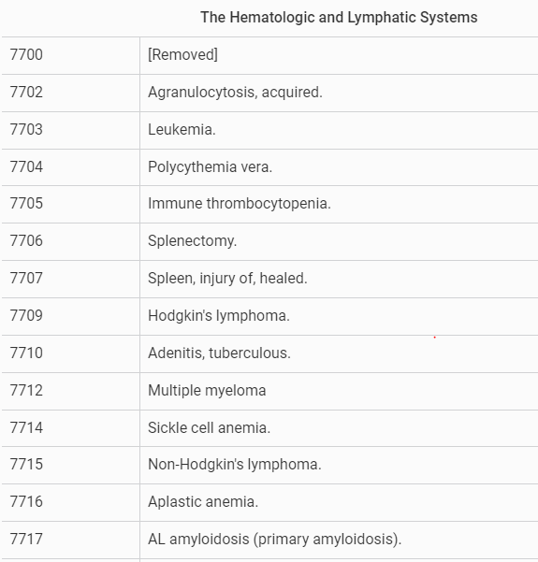
§ 4.117 Schedule of Ratings –7700-7717
Notes:
Agent Orange—3, 9, 15, 12
Atomic Veterans (exposed to ionizing radiation) all leukimia (except chronic lymphocytic), 12,

Slide 3
38 CFR 3.105(e)
Reduction in evaluation - compensation. Where the reduction in evaluation of a service-connected disability or employability status is considered warranted and the lower evaluation would result in a reduction or discontinuance of compensation payments currently being made, a rating proposing the reduction or discontinuance will be prepared setting forth all material facts and reasons. The beneficiary will be notified at his or her latest address of record of the contemplated action and furnished detailed reasons therefor, and will be given 60 days for the presentation of additional evidence to show that compensation payments should be continued at their present level. Unless otherwise provided in paragraph (i) of this section, if additional evidence is not received within that period, final rating action will be taken and the award will be reduced or discontinued effective the last day of the month in which a 60-day period from the date of notice to the beneficiary of the final rating action expires.
Notes:
Ok to start with, I pulled up the “ “ because it’s reference in like, half of the codes we are going over today. This is just the explanation that the VA can’t reduce without giving the applicant time to refute it.
“to sum this up – VA must give a 60 day notice prior to reduction is finalized.”

Slide 4
7702 Agranulocytosis, acquired:
Requiring bone marrow transplant; or infections recurring, on average, at least once every six weeks per 12-month period
100
Requiring intermittent myeloid growth factors (granulocyte colony-stimulating factor (G-CSF) or granulocyte-macrophage colony-stimulating factor (GM-CSF) or continuous immunosuppressive therapy such as cyclosporine to maintain absolute neutrophil count (ANC) greater than 500/microliter (µl) but less than 1000/µl; or infections recurring, on average, at least once every three months per 12-month period
60
Requiring intermittent myeloid growth factors to maintain ANC greater than 1000/µl; or infections recurring, on average, at least once per 12-month period but less than once every three months per 12-month period
30
Requiring continuous medication (e.g., antibiotics) for control; or requiring intermittent use of a myeloid growth factor to maintain ANC greater than or equal to 1500/µl
10
Note: A 100 percent evaluation for bone marrow transplant shall be assigned as of the date of hospital admission and shall continue with a mandatory VA examination six months following hospital discharge. Any change in evaluation based upon that or any subsequent examination shall be subject to the provisions of § 3.105(e) of this chapter
Notes:
Agranulocytosis, also known as agranulosis or granulopenia, is an acute condition involving a severe and dangerous lowered white blood cell count (leukopenia, most commonly of neutrophils) and thus causing a neutropenia in the circulating blood.^{[1]} It is a severe lack of one major class of infection-fighting white blood cells. People with this condition are at very high risk of serious infections due to their suppressed immune system.
In agranulocytosis, the concentration of granulocytes (a major class of white blood cells that includes neutrophils, basophils, and eosinophils) drops below 200 cells/mm³ of blood.
Myeloid--Having to do with or resembling the bone marrow. May also refer to certain types of hematopoietic (blood-forming) cells found in the bone marrow. Sometimes used as a synonym for myelogenous; for example, acute myeloid leukemia and acute myelogenous leukemia are the same disease.
Absolute Neutrophil Count—ANC An absolute neutrophil count identifies how many neutrophils are in a sample of your blood. The normal range of neutrophils in a healthy adult is between 2,500 and 7,000 neutrophils per microliter of blood. Any number above 7,000 or below 2,500 puts you at risk of a neutrophil condition
µl—microliter
I didn’t see this on the presumptive list, but interestingly enough, as I was researching, I found that chemotherapy is one of the causes for the “”. Other causes include autoimmune disorders, bone marrow disease, exposure to such toxins as lead or mercury, infections such as tuberculosis, certain prescription drugs including antibiotics, antipsychotics, and thyroid medications. “Acute Myeloid Leukemia is one of the most appeals to the BVA conditions cused by Agent orange and is often granted due to its close relationship to B cell leukemia which is presumptive”

Slide 5
7703 Leukemia (except for chronic myelogenous leukemia):
When there is active disease or during a treatment phase
100
Otherwise rate residuals under the appropriate diagnostic code(s)
Chronic lymphocytic leukemia or monoclonal B-cell lymphocytosis (MBL), asymptomatic, Rai Stage
00
Presumptive for both Agent Orange and Atomic Veterans (those exposed to ionizing radiation)
Note (1): A 100 percent evaluation shall continue beyond the cessation of any surgical therapy, radiation therapy, antineoplastic chemotherapy, or other therapeutic procedures. Six months after discontinuance of such treatment, the appropriate disability rating shall be determined by mandatory VA examination. Any change in evaluation based upon that or any subsequent examination shall be subject to the provisions of § 3.105(e) of this chapter. If there has been no recurrence, rate on residuals
Note (2): Evaluate symptomatic chronic lymphocytic leukemia that is at Rai Stage I, II, III, or IV the same as any other leukemia evaluated under this diagnostic code
Note (3): Evaluate residuals of leukemia or leukemia therapy under the appropriate diagnostic code(s). Myeloproliferative Disorders: (Diagnostic Codes 7704, 7718, 7719)
Notes:
Leukemia is cancer of the blood. Chronic myelogenous leukemia--A type of white blood cell cancer that is caused due to an acquired genetic defect. This causes bone pain, fever, night sweats, easy bleeding, fatigue, and weight loss.
Lymphocytic/lymphocyte--a form of small leukocyte (white blood cell) with a single round nucleus, occurring especially in the lymphatic system.
A type of cancer that begins in the lymphocytes of bone marrow and extends into the blood. This causes painless enlarged lymph nodes, pain in upper left side of abdomen, night sweats, weight loss, and fever.
Monoclonal B-cell lymphocytosis (MBL) is an asymptomatic hematologic condition defined by the presence of a small (<5 x 109/L) clonal B-cell population in the peripheral blood in the absence of lymph-node enlargement, cytopenias or autoimmune diseases. It is found in approximately 3-12% of normal persons depending on the accuracy of analytical techniques applied.
Rai Stage there are 5 stages from low risk to high risk

Slide 6
7704 Polycythemia vera:
Requiring peripheral blood or bone marrow stem-cell transplant or chemotherapy (including myelosuppressants) for the purpose of ameliorating the symptom burden
100
Requiring phlebotomy 6 or more times per 12-month period or molecularly targeted therapy for the purpose of controlling RBC count
60
Requiring phlebotomy 4-5 times per 12-month period, or if requiring continuous biologic therapy or myelosuppressive agents, to include interferon, to maintain platelets <200,000 or white blood cells (WBC) <12,000
30
Requiring phlebotomy 3 or fewer times per 12-month period or if requiring biologic therapy or interferon on an intermittent basis as needed to maintain all blood values at reference range levels
10
Note (1): Rate complications such as hypertension, gout, stroke, or thrombotic disease separately Note (2): If the condition undergoes leukemic transformation, evaluate as leukemia under diagnostic code 7703 Note (3): A 100 percent evaluation shall be assigned as of the date of hospital admission for peripheral blood or bone marrow stem cell transplant; or during the period of treatment with chemotherapy (including myelosuppressants). Six months following hospital discharge or, in the case of chemotherapy treatment, six months after completion of treatment, the appropriate disability rating shall be determined by mandatory VA examination. Any reduction in evaluation based upon that or any subsequent examination shall be subject to the provisions of § 3.105(e) of this chapter
Notes:
Polycythemia vera (pol-e-sy-THEE-me-uh VEER-uh) is a type of blood cancer. It causes your bone marrow to make too many red blood cells. These excess cells thicken your blood, slowing its flow, which may cause serious problems, such as blood clots. Polycythemia vera is rare
Ameliorating—to make (something bad or unsatisfactory) better
RBC count (red blood cell count)
Causes aren’t known, so this isn’t on the presumptive list.

Slide 7
7705 Immune thrombocytopenia:
Requiring chemotherapy for chronic refractory thrombocytopenia; or a platelet count 30,000 or below despite treatment
100
Requiring immunosuppressive therapy; or for a platelet count higher than 30,000 but not higher than 50,000, with history of hospitalization because of severe bleeding requiring intravenous immune globulin, high-dose parenteral corticosteroids, and platelet transfusions
70
Platelet count higher than 30,000 but not higher than 50,000, with either immune thrombocytopenia or mild mucous membrane bleeding which requires oral corticosteroid therapy or intravenous immune globulin
30
Platelet count higher than 30,000 but not higher than 50,000, not requiring treatment
10
Platelet count above 50,000 and asymptomatic; or for immune thrombocytopenia in remission
0
Note (1): Separately evaluate splenectomy under diagnostic code 7706 and combine with an evaluation under this diagnostic code
Note (2): A 100 percent evaluation shall continue beyond the cessation of chemotherapy. Six months after discontinuance of such treatment, the appropriate disability rating shall be determined by mandatory VA examination. Any reduction in evaluation based upon that or any subsequent examination shall be subject to the provisions of § 3.105(e) of this chapter
Notes:
Immune thrombocytopenia (ITP) is a type of platelet disorder. In ITP, your blood does not clot as it should, because you have a low platelet count. Platelets are tiny blood cells that are made in the bone marrow. When you are injured, platelets stick together to form a plug that seals your wound.
This illness is characterized as having the low platelet count, without having anemia or leukopenia. Like agranulocytosis, this condition is often caused by other serious conditions. rating may be adjusted based on changes in your condition or reevaluated following chemotherapy to see where you stand

Slide 8
7706 Splenectomy
 | 20
Note: Separately rate complications such as systemic infections with encapsulated bacteria
Note: Separately rate complications such as systemic infections with encapsulated bacteria
7707 Spleen, injury of, healed.
Rate for any residuals.
Notes:
Splenectomy is a surgical procedure to remove your spleen. The spleen is an organ that sits under your rib cage on the upper left side of your abdomen. It helps fight infection and filters unneeded material, such as old or damaged blood cells, from your blood.

Slide 9
7709 Hodgkin's lymphoma:
With active disease or during a treatment phase
100
Note: A 100 percent evaluation shall continue beyond the cessation of any surgical therapy, radiation therapy, antineoplastic chemotherapy, or other therapeutic procedures. Six months after discontinuance of such treatment, the appropriate disability rating shall be determined by mandatory VA examination. Any reduction in evaluation based upon that or any subsequent examination shall be subject to the provisions of § 3.105(e) of this chapter. If there has been no local recurrence or metastasis, rate on residuals under the appropriate diagnostic code(s)
7715 Non-Hodgkin's lymphoma:
Both are presumptive for Agent Orange
When there is active disease, during treatment phase, or with indolent and non-contiguous phase of low grade NHL
100
Note: A 100 percent evaluation shall continue beyond the cessation of any surgical therapy, radiation therapy, antineoplastic chemotherapy, or other therapeutic procedures. Two years after discontinuance of such treatment, the appropriate disability rating shall be determined by mandatory VA examination. Any reduction in evaluation based upon that or any subsequent examination shall be subject to the provisions of § 3.105(e) of this chapter. If there has been no recurrence, rate on residuals under the appropriate diagnostic code(s)
Notes:
Hodgkin's lymphoma is a type of cancer that affects the lymphatic system, which is part of the body's germ-fighting immune system. In Hodgkin's lymphoma, white blood cells called lymphocytes grow out of control, causing swollen lymph nodes and growths throughout the body
Non-Hodgkin lymphoma is a disease in which malignant (cancer) cells form in the lymph system. Non-Hodgkin lymphoma is a type of cancer that forms in the lymph system. The lymph system is part of the immune system. It helps protect the body from infection and disease.
If in examining the cells, the doctor detects the presence of a specific type of abnormal cell called a Reed-Sternberg cell, the lymphoma is classified as Hodgkin's. If the Reed-Sternberg cell is not present, the lymphoma is classified as non-Hodgkin's.

Slide 10
7712 Multiple myeloma:
Presumptive for both Agent Orange and Atomic Veterans
7710 Adenitis, tuberculous, active or inactive:
Rate under § 4.88c or 4.89 of this part, whichever is appropriate
Symptomatic multiple myeloma
100
Asymptomatic, smoldering, or monoclonal gammopathy of undetermined significance (MGUS)
0
Note (1): Current validated biomarkers of symptomatic multiple myeloma and asymptomatic multiple myeloma, smoldering, or monoclonal gammopathy of undetermined significance (MGUS) are acceptable for the diagnosis of multiple myeloma as defined by the American Society of Hematology (ASH) and International Myeloma Working Group (IMWG)
Note (2): The 100 percent evaluation shall continue for five years after the diagnosis of symptomatic multiple myeloma, at which time the appropriate disability evaluation shall be determined by mandatory VA examination. Any reduction in evaluation based upon that or any subsequent examination shall be subject to the provisions of § 3.105(e) and § 3.344 (a) and (b) of this chapter
Notes:
Tuberculosis (TB) is a potentially serious infectious disease that mainly affects the lungs. The bacteria that cause tuberculosis are spread from person to person through tiny droplets released into the air via coughs and sneezes
Adenitis is a general term for an inflammation of a gland. Often it is used to refer to lymphadenitis which is the inflammation of a lymph node. Adenitis. Specialty. Endocrinology
Tuberculous lymphadenitis is a chronic, specific granulomatous inflammation of the lymph node with caseation necrosis, caused by infection with Mycobacterium tuberculosis or related bacteria. The characteristic morphological element is the tuberculous granuloma (caseating tubercule).
Myeloma, also called multiple myeloma, is a cancer of the plasma cells. Plasma cells are white blood cells that make antibodies that protect us from infection. In myeloma, the cells grow too much, crowding out normal cells in the bone marrow that make red blood cells, platelets, and other white blood cells.
CFR 3.344(a)&(b) give guidelines for rating without having an actual guideline to follow

Slide 11
7714 Sickle cell anemia:
With at least 4 or more painful episodes per 12-month period, occurring in skin, joints, bones, or any major organs, caused by hemolysis and sickling of red blood cells, with anemia, thrombosis, and infarction, with residual symptoms precluding even light manual labor
100
With 3 painful episodes per 12-month period or with symptoms precluding other than light manual labor
60
With 1 or 2 painful episodes per 12-month period
30
Asymptomatic, established case in remission, but with identifiable organ impairment
10
Note: Sickle cell trait alone, without a history of directly attributable pathological findings, is not a ratable disability. Cases of symptomatic sickle cell trait will be forwarded to the Director, Compensation Service, for consideration under § 3.321(b)(1) of this chapter
Disability compensation. Ratings shall be based, as far as practicable, upon the average impairments of earning capacity with the additional proviso that the Secretary shall from time to time readjust this schedule of ratings in accordance with experience. To accord justice to the exceptional case where the schedular evaluation is inadequate to rate a single service-connected disability, the Director of Compensation Service or his or her delegate is authorized to approve on the basis of the criteria set forth in this paragraph (b), an extra-schedular evaluation commensurate with the average impairment of earning capacity due exclusively to the disability. The governing norm in these exceptional cases is a finding by the Director of Compensation Service or delegatee that application of the regular schedular standards is impractical because the disability is so exceptional or unusual due to such related factors as marked interference with employment or frequent periods of hospitalization.
Notes:
Sickle cell anemia is one of a group of inherited disorders known as sickle cell disease. It affects the shape of red blood cells, which carry oxygen to all parts of the body.
Red blood cells are usually round and flexible, so they move easily through blood vessels. In sickle cell anemia, some red blood cells are shaped like sickles or crescent moons. These sickle cells also become rigid and sticky, which can slow or block blood flow.
Disability compensation. Ratings shall be based, as far as practicable, upon the average impairments of earning capacity with the additional proviso that the Secretary shall from time to time readjust this schedule of ratings … The governing norm in these exceptional cases is a finding by the Director of Compensation Service or delegatee that application of the regular schedular standards is impractical because the disability is so exceptional or unusual due to such related factors as marked interference with employment or frequent periods of hospitalization.
What this is saying, is that this is so inconsistent and case by case, that the Director will have to determine these ratings case by case.
This would be a very rare Service connection

Slide 12
7716 Aplastic anemia:
Requiring peripheral blood or bone marrow stem cell transplant; or requiring transfusion of platelets or red cells, on average, at least once every six weeks per 12-month period; or infections recurring, on average, at least once every six weeks per 12-month period
100
Requiring transfusion of platelets or red cells, on average, at least once every three months per 12-month period; or infections recurring, on average, at least once every three months per 12-month period; or using continuous therapy with immunosuppressive agent or newer platelet stimulating factors
60
Requiring transfusion of platelets or red cells, on average, at least once per 12-month period; or infections recurring, on average, at least once per 12-month period
30
Note (1): A 100 percent evaluation for peripheral blood or bone marrow stem cell transplant shall be assigned as of the date of hospital admission and shall continue with a mandatory VA examination six months following hospital discharge. Any change in evaluation based upon that or any subsequent examination shall be subject to the provisions of § 3.105(e) of this chapter
Note (2): The term “newer platelet stimulating factors” includes medication, factors, or other agents approved by the United States Food and Drug Administration
Notes:
Aplastic anemia is a condition that occurs when your body stops producing enough new blood cells. The condition leaves you fatigued and more prone to infections and uncontrolled bleeding. A rare and serious condition, aplastic anemia can develop at any age.

Slide 13
7717 AL amyloidosis (primary amyloidosis) Agent Orange Presumptive
100
Notes:
AL amyloidosis (amyloid light chain or primary amyloidosis) is a rare disease that happens when abnormal light chain proteins in your body gather on your organs and tissues. It's a serious illness that may become chronic or may cause life-threatening medical conditions.

Slide 14

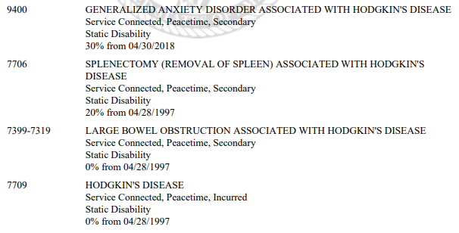

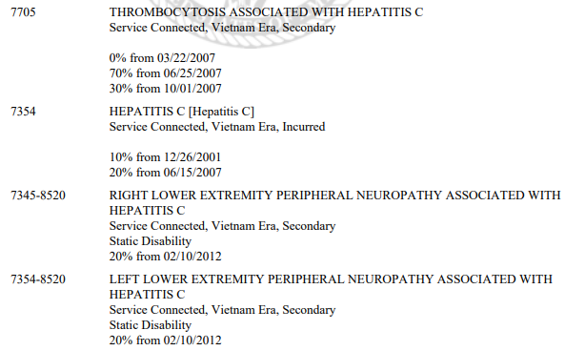
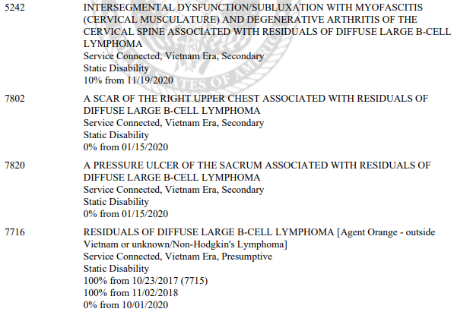
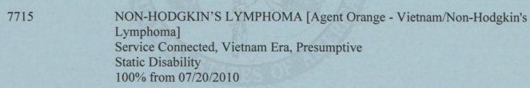
Notes:
An important note is that for these issues to be SC they are most likely going to be diagnosed in service or found to be presumptive conditions. Issues Like this that develop after Service that are not presumptive will need a medical nexus to service and often have to go to BVA.

